Slide 1
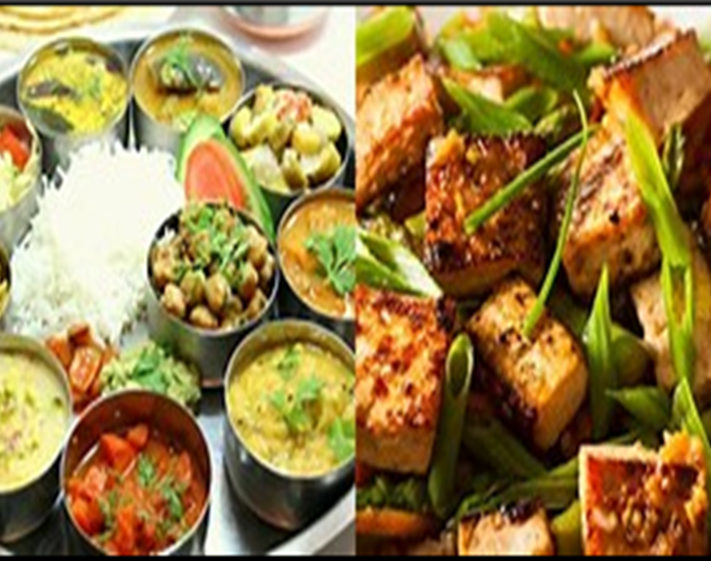

Case Study- Fast food shop (A case study for the loss of new fast food shop after 4-5 month in BTM Layout , Bangalore)

Slide 2
Introduction:
Problem: A man has took a shop in Rent near BTM Layout, Bangalore, not in the main road but as a local shop. The rent of the shop is 14000 per month. The man took the shop to sell fast food like - Biryani, Maggie, Egg Bhujia, Omlets, Chicken Kabab etc.
In the first 3 months he make a profit of around 100000, with a sales of around 300000.
In the 1st month he was selling veg food also, but he stopped after the 2nd month as it stock was not getting out.
After 4 – 5 months down the line the man is making a huge loss in his investment. He has a due of 2 months to pay the rent.
The sale has drastically gone down and he is thinking to close the shop.

Slide 3
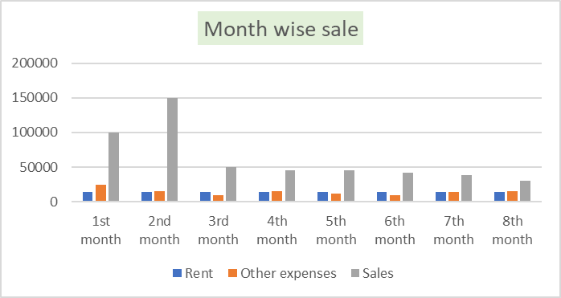

Slide 4
LIST OF VEG RESTAURANTS NEAR BTM LAYOUT

Slide 5
Pricing
Pricing of loss person shop food price
Pricing of other competitors shops

Slide 6
Problem solving by Design thinking method
Empathize:
Since his shop is not there in the main road so that people were not connected that much about his shop.
There were already some vegetarian food shops near his shop so that he could not compete with them.
Some online food delivery already available from other shops in that area.
Not well Known in market
Pay bills on time
Not for Party celebration
The price of food item is more while comparing other shops.
Short business hours

Slide 7
Define:
Social media Platform like Instagram, Facebook , Just dial.
Home delivery
Outdoor seating
Affordable price with different types of food
Mainly Students, Couples, Employees

Slide 8
Ideate:
Customer acquisition by Quality , Price and quantity of food.
Provide Hygiene food
Morning and afternoon slots only for Veg food and evening and night slots for only fast food.
Strong brandling and local market deep knowledge

Slide 9
Prototype:
Delivery mode like Zomato , Swiggy, Foodpanda
High hygiene with verity of offering
Affordable Price
Best service and Amenities compare to others

Slide 10
Text:
Daily feedback taking from customer about quality of food.
Feedback of Service and Amenities
Value of money

